Slide 1
Migrating to ‘C’

Slide 2


Why did We Learn Python?
Easy to learn
Language with simple rules
Good for beginners
Code is readable
Less development time
No memory management
Great support for building web apps
Dynamic language and no type checking

Slide 3

Limitations of Python
Python is not a good choice for:
Memory intensive and computation intensive tasks
Embedded Systems where processor has limited capacity
For graphic intensive 3D game that takes up a lot of CPU
Applications that demand concurrency and parallelism
Developing mobile apps
Design restrictions
Interpreted language and is slow compared to C/C++ or Java

Slide 4

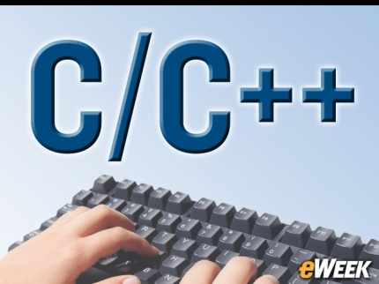
Why to learn more languages?
Similar to why a carpenter has more than just a hammer in his/her toolbox
Every programming language has its positive and negative points
One language cannot do everything
That is why there are many languages; some are fantastic for some things
Eg: C/C++ is typically the benchmark for speed and memory usage, and some languages provide strengths elsewhere (Eg: Python is very easy to pick up)

Slide 5

Transiting from Python to C/C++
Will not be so hard
There are quite a few syntax differences between the two languages
Only way to learn a new programming language is by writing programs in it
Dennis Ritchie

Slide 6

History of C
Born at AT & T Bell Laboratory of USA in 1972
Many of C’s principles and ideas were derived from the earlier language B
Ken Thompson was the developer of B Language
C was written by Dennis Ritchie
http://www.nytimes.com/2011/10/14/technology/dennis-ritchie-programming-trailblazer-dies-at-70.html?_r=0
C language was created for a specific purpose i.e designing the UNIX operating system (which is currently base of many UNIX based OS)
Quickly spread beyond Bell Labs in the late 70’s because of its strong features

Slide 7

About Dennis Ritchie
Born September 9, 1941
Known for ALTRAN, B, BCPL, C, Multics, Unix
Won Turing Award in 1983
Developed C language which is widely used developing, operating systems, compiler, and embedded system development, Assemblers, Text editors, Print Spoolers, Network drivers databases etc and its influence is seen in most modern programming languages
Died on October 12, 2011

Slide 8

Features of C language
Portability - C Programs can run on any compiler with little or no modification
Low level features: C provides low level features and is closely related to lower level assembly Languages
Modular programming - software design technique that increases the extent to which software is composed of separate parts, called modules
Has many successor languages which are designed to look like C, e.g., C++, C#, Objective-C, Java, JavaScript, PHP and Perl.

Slide 9

C is a structured programming language
Divides the large problem in to smaller modules called functions or procedures
Each function or module handles the particular task and the collection of all the functions is called a program, which solves the large problem
Easier to modify and debug

Slide 10

Modularity in Technology and Management
Product systems are deemed “modular”
They can be decomposed into a number of components that may be mixed and matched in a variety of configurations
Components are able to connect, interact, or exchange resources
Plugs and plug points are independent, may be manufactured even by different companies

Slide 11
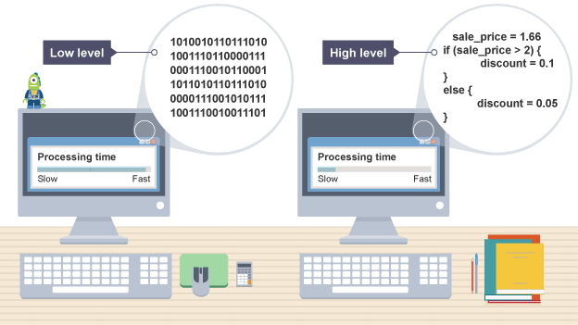
Difference between Python and C
C programs – Compiled
Python programs – Interpretered
Compiler | Interpreter
Takes entire program as input and generate a output file with object code | Takes instruction by instruction as input and gives an output. But does not generate a file
Errors are displayed after entire program is checked | Errors are displayed for every instruction interpreted (if any)

Slide 12
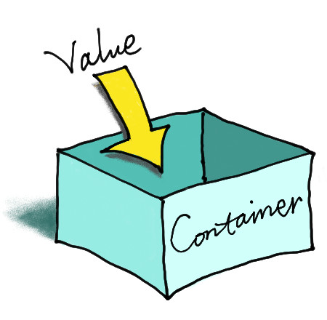
Variable Declaration in C
In C, it is mandatory to do variable declaration
We say variable's type, whether it is an integer (int), floating-point number (float), character (char) etc
Syntax is type of variable, white space, name of variable semicolon
Eg: int number;

Slide 13
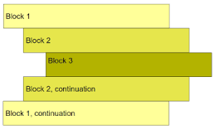
White spaces and Intendation
No problem of difference between white space and tab in C (Happy!)
Block of code in C need not be intended as in Python
In C, Curly braces are used for giving a block of code Eg: Block of code in ‘C’
{
-----
}

Slide 14
Problem
Little Bob loves chocolate, and he goes to a store with Rs. N in his pocket. The price of each chocolate is Rs. C. The store offers a discount: for every M wrappers he gives to the store, he gets one chocolate for free. This offer is available only once. How many chocolates does Bob get to eat?

Slide 15
PAC For Chocolate Problem
Input | Processing | Output
Amount in hand, N Price of one chocolate, C Number of wrappers for a free chocolate, M | Number of Chocolates P = Quotient of N / C Free chocolate F = Quotient of P/M | Total number of chocolates got by Bob

Slide 16
Pseudocode
READ N and C
COMPUTE num_of_chocolates as N/C
CALCULATE returning_wrapper as number of chocolates/m
TRUNCATE decimal part of returning_wrapper
COMPUTE Chocolates_recieved as num_of_chocolates + returning_wrapper
PRINT Chocolates_recieved

Slide 17
Knowledge Required
Following knowledge is required in C to write a code to solve the above problem
Read input from user
Data types in Python
Perform arithmetic calculations
Write output

Slide 18
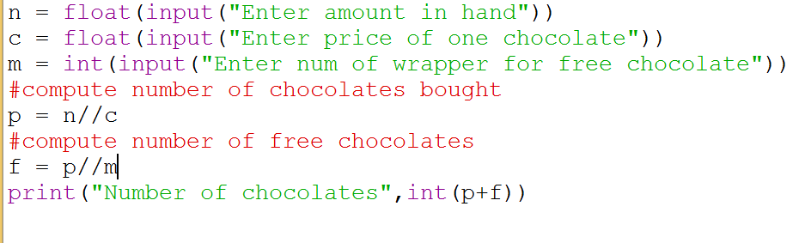
Python Program for Bob Problem

Slide 19
Layout of a C program
pre-processor directives – Preceded by a ‘#’
global declarations – Optional and not a good programming practice
int main() - standard start for all C programs
{
local variables to function main ; - all variables used in the function must be declared in the beginning
statements associated with function main ;
}
void f1()
{
local variables to function 1 ;
statements associated with function 1 ;
}

Slide 20
Components of a C program
A C program consists of the following parts:
Comments
Variables
Preprocessor Commands
Functions
Statements & Expressions

Slide 21
Comments in C
Two types of comments
Single line and multi line comment
Single Line Comment is double forward slash ‘//’ and can be Placed Anywhere

Slide 22
Multiline Comments in C
Multi line comment can be placed anywhere
Multi line comment starts with /*
Multi line comment ends with */
Any symbols written between '/*’ and '*/‘ are ignored by Compiler

Slide 23
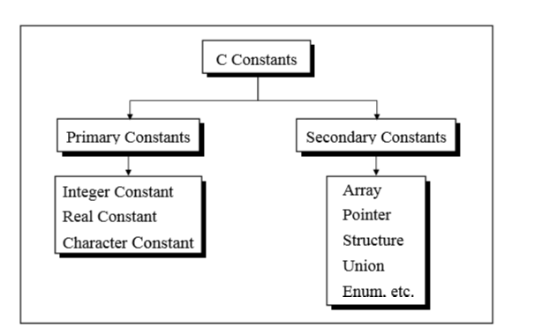
Types of C Constants
Now Restrict Discussion to Primary Constants

Slide 24
Data types in C
Basic Arithmetic types - further classified into: (a) integer types and (b) floating-point types
Enumerated types - arithmetic types that are used to define variables that can be assigned only certain discrete integer values throughout the program
Type void - indicates that no value is available
Derived types - They include (a) Pointer types, (b) Array types, (c) Structure types, (d) Union types and (e) Function types

Slide 25
Broad Classification of Data Types
Numerical data types are broadly classified into
Signed
Unsigned
Signed can store zero, positive and negative values
Unsigned can store only zero and positive values
Char and bool are unsigned data types
Some applications use unsigned data types only Eg: age

Slide 26
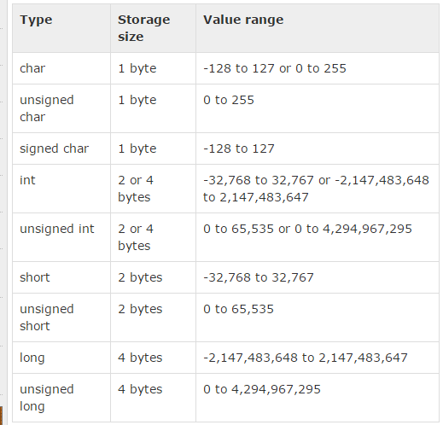
Integer Types

Slide 27
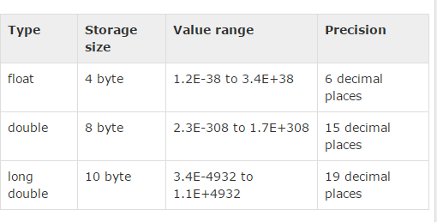
Floating Point Types

Slide 28
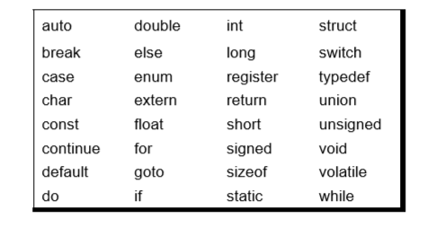
Keywords
32 keywords available in C
Compiler vendors (like Microsoft, Borland, etc.) provide their own keywords

Slide 29
Discuss Valid and Invalid variable names
BASICSALARY
_basic
basic-hra
#MEAN
group.
422
population in 2006
FLOAT
hELLO

Slide 30
I/O in C
Basic operation in any language
Input is got through a function scanf which is equivalent to input or raw_input in Python
Syntax of scanf
int scanf(const char *format, ...)
Basically two or more arguments
First format string, followed by address of variables that are going to hold values entered by user

Slide 31
I/O in C
Basic operation in any language
Input is got through a function scanf which is equivalent to input or raw_input in Python
Syntax of scanf
int scanf(const char *format, ...)
Basically one or more arguments
First format string, followed by address of variables that are going to hold values entered by user

Slide 32
I/O in C
int printf(const char *format, ...)
contains one or more arguments
first argument is the format string

Slide 33
printf and scanf format codes
code | type | format
d | int | decimal (base ten) number
o | int | octal number (no leading '0' supplied in printf)
x or X | int | hexadecimal number (no leading '0x' supplied in printf; accepted if present in scanf) (for printf, 'X' makes it use upper case for the digits ABCDEF)
ld | long | decimal number ('l' can also be applied to any of the above to change the type from 'int' to 'long')

Slide 34
printf and scanf format codes
code | type | format
u | Unsigned int | decimal number
lu | unsigned long | decimal number
c | char [footnote] | single character
s | char pointer | string
f | float [footnote] | number with six digits of precision
lf | double [footnote] | number with six digits of precision

Slide 35
Address of a variable
Address of a variable can be obtained by putting a ‘&’ before the variable name

Slide 36
Example 1
#include<stdio.h> void main() { int a = 27; int b = 25; int c = a -b; printf("%d",c); }

Slide 37
Output 1
2

Slide 38
Example 2
#include<stdio.h> void main() { char a = 273; char b = 25; int c = a%b; printf("%d",c); }

Slide 39
Output 2
warning: overflow in implicit constant conversion [-Woverflow]
17
Character – range is 0 to 255
256 is 0
257 is 1 and so on

Slide 40
Example 3
#include<stdio.h> void main() { char a = 27; char b = 25; char c = a -b; printf("%c",c); }

Slide 41
Output 3
A special character

Slide 42
Arithmetic Operators in C
Operator | Description
+ | Adds two operands
− | Subtracts second operand from the first.
∗ | Multiplies both operands
∕ | Divides numerator by denominator
% | Modulus Operator and remainder of after an integer division.
++ | Increment operator increases the integer value by one
-- | Decrement operator decreases the integer value by one

Slide 43
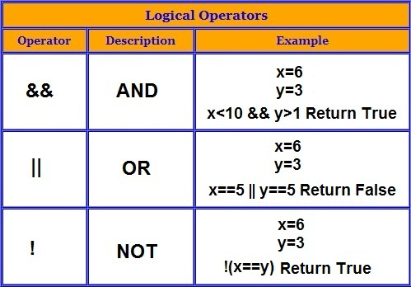

Slide 44
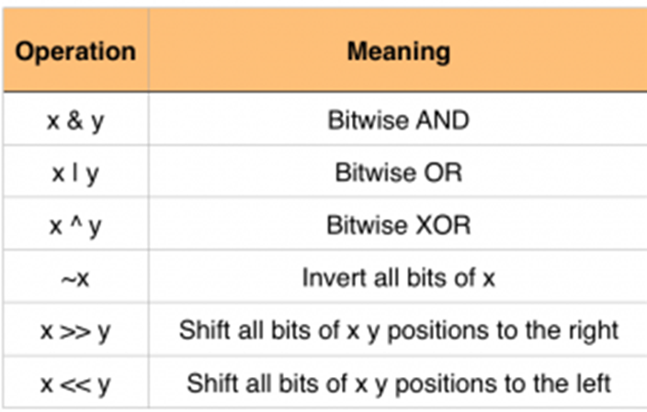

Slide 45
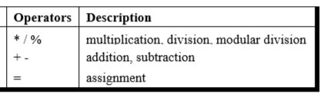
Precedence of Operators in C
++, -- Post increment Operators
++, -- Pre increment Operators
Parenthesis can be used to override default precedence

Slide 46
Example 4
#include<stdio.h> main() { int a, b,c; a = 4; b = 2; c = -a+--b; printf ( "c = %d", c) ; }

Slide 47
Output 4
c = -3

Slide 48
Example 5
#include<stdio.h> main() { int a, b,c; a = 4; b = 2; c = -a+ b--; printf ( "c = %d", c) ;
printf ( "b = %d", b) ; }

Slide 49
Output 5
c = -2
b = 1

Slide 50
Example 6
#include<stdio.h> main() { int a, b,c; a = 4; c = ++a + a++; printf ( "c = %d", c) ; printf ( "a = %d", a) ; }

Slide 51
Output 6
c = 10 a = 6

Slide 52
Example 7
#include<stdio.h> main() { int a, b,c; a = 4; c = ++a + ++a; printf ( "c = %d", c) ; printf ( "a = %d", a) ; }

Slide 53
Output 7
c = 12 a = 6

Slide 54
Example 8
#include<stdio.h> main() { int a, b,c; a = 4; c = a++ + ++a; printf ( "c = %d", c) ; printf ( "a = %d", a) ; }

Slide 55
Output 8
c = 10 a = 6

Slide 56
Associativity of Operators in C
When precedence of two operators are same then associativity of operator is considered for evaluation

Slide 57
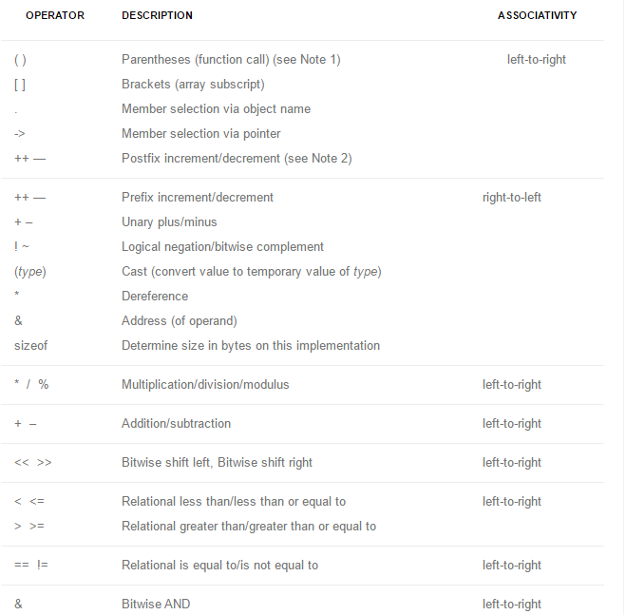

Slide 58
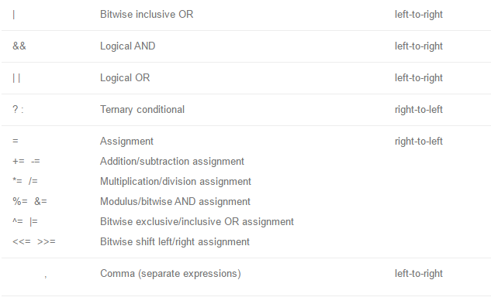

Slide 59
Automatic Type Conversion in C
Convert a variable from one data type to another data type
When the type conversion is performed automatically by the compiler without programmers intervention, such type of conversion is known as implicit type conversion or type promotion.
The compiler converts all operands into the data type of the largest operand.

Slide 60
Rules for Implicit Type Conversion in C
Sequence of rules that are applied while evaluating expressions are given below:
All short and char are automatically converted to int, then,
If either of the operand is of type long double, then others will be converted to long double and result will be long double.
Else, if either of the operand is double, then others are converted to double.
Else, if either of the operand is float, then others are converted to float.

Slide 61
Rules for Type Conversion in C
Else, if either of the operand is unsigned long int, then others will be converted to unsigned long int.
Else, if one of the operand is long int, and the other is unsigned int, then
if a long int can represent all values of an unsigned int, the unsigned int is converted to long int.
otherwise, both operands are converted to unsigned long int.
Else, if either operand is long int then other will be converted to long int.
Else, if either operand is unsigned int then others will be converted to unsigned int.

Slide 62
Example 9
#include<stdio.h> void main() { char a = 65; char b = 100; int c = a%b; printf("%c",c); }

Slide 63
Output 9
A

Slide 64
Example 10
#include<stdio.h> void main() { int a = 165; int b = 100; int c = a/b; printf("%d",c); }

Slide 65
Output 10
1

Slide 66
Example 11
#include<stdio.h> void main() { int a = 165; int b = 100; float c = a/b; printf("%f",c); }

Slide 67
Output 11
- 1.000000

Slide 68
Example 12
#include<stdio.h> void main() { int a = 165; int b = 100; float c = a/b; printf("%f",c); }

Slide 69
Output 12
- 1.000000

Slide 70
Example 13
#include<stdio.h> void main() { int a = 165; float b = 100; float c = a/b; printf("%f",c); }

Slide 71
Output 13
- 1.650000

Slide 72
Explicit Type Conversion
Type conversion performed by the programmer is known as explicit type conversion
Explicit type conversion is also known as type casting.
Type casting in c is done in the following form:
(data_type)expression;
where, data_type is any valid c data type, and expression may be constant, variable or an expression
For example, x=(int)a+b*d;

Slide 73
Explicit Type Conversion
The following rules have to be followed while converting the expression from one type to another to avoid the loss of information:
All integer types to be converted to float.
All float types to be converted to double.
All character types to be converted to integer.

Slide 74
Example 14
#include<stdio.h> void main() { int a = 165; int b = 100; float c = (float)(a/b); printf("%f",c); }

Slide 75
Output 14
1.000000

Slide 76
Example 15
#include<stdio.h> void main() { int a = 165; int b = 100; float c = (float) a/b; printf("%f",c); }

Slide 77
Output 15
1.650000

Slide 78
Assignment
Students have to check all operators for all types of operands, also work on to understand precedence of operators

Slide 79
Declaration and Definition of Variables in C
Declaration – Information to compiler about the variable
Definition – Memory is allocated for the variable according to type
For all storage classes declaration and definition are same except for extern
When a keyword extern precedes, its only a declaration and the compiler waits for definition without raising error

Slide 80
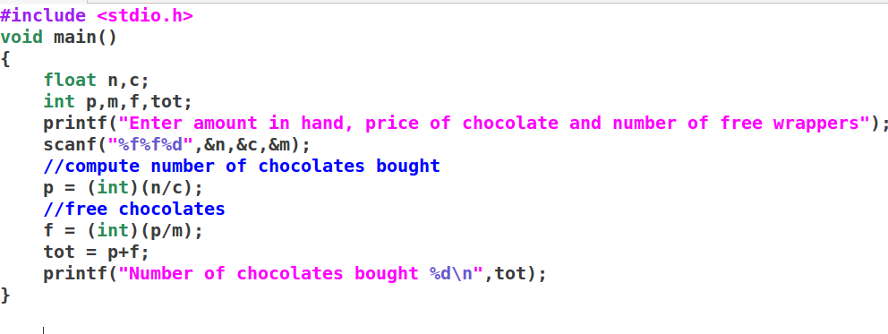

Slide 81
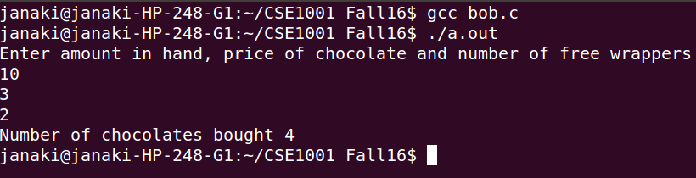

Slide 82
Problem
ABC company Ltd. is interested to computerize the pay calculation of their employee in the form of Basic Pay, Dearness Allowance (DA) and House Rent Allowance (HRA). DA and HRA are calculated as certain % of Basic pay(For example, DA is 80% of Basic Pay, and HRA is 30% of Basic pay). They have the deduction in the salary as PF which is 12% of Basic pay. Propose a computerized solution for the above said problem.
Input : Basic Pay
Process : Calculate Salary
( Basic Pay + ( Basic Pay * 0.8) + ( Basic Pay * 0.3 - ( Basic Pay * 0.12)
-----------allowances -------------- --- deductions----
Output : Salary

Slide 83
Problem
Find the average runs scored by a batsman in 4 matches
Area of a circle

Slide 84
Exercise
An university is setting up a new lab at their premises. Design an algorithm and write Python code to determine the approximate cost to be spent for setting up the lab. Cost for setting the lab is sum of cost of computers, cost of furnitures and labour cost. Use the following formulae for solving the problem:
Cost of computer = cost of one computer * number of computers
Cost of furniture = Number of tables * cost of one table + number of chairs * cost of one chair
Labour cost = number of hours worked * wages per hour

